Slide 1
EBRUxMTG
Shawn Francis, John Kasperbauer, Zach Leach, Ashley Nguyen, Dustin Nguyen, Toluwanimi Ololade, Hayden Rogers

Slide 2
Introduction and Background
Notes:
Zach: Introduce and provide context for our database project

Slide 3
Problem
Scryfall outputs the *images* of cards given a query.
But sometimes you need the *names* of cards instead.
Currently, there is no streamlined way to do this.

Slide 4
Solution
Create our own application that *can* output the names of cards given a query

Slide 5
Why does it matter?
Example 1: MTGPrint (card printing)
Example 2: Moxfield bulk editing (online deck building)

Slide 6
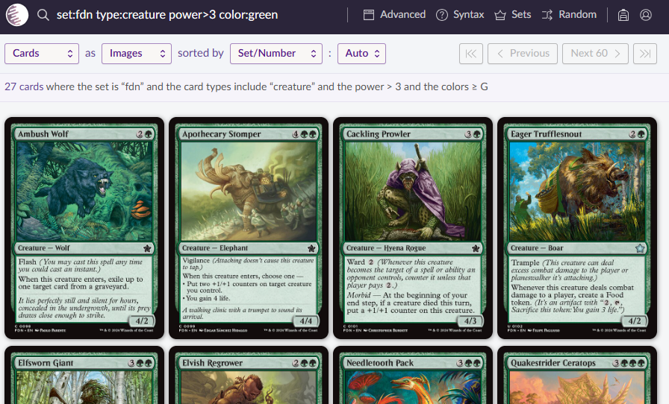

Slide 7
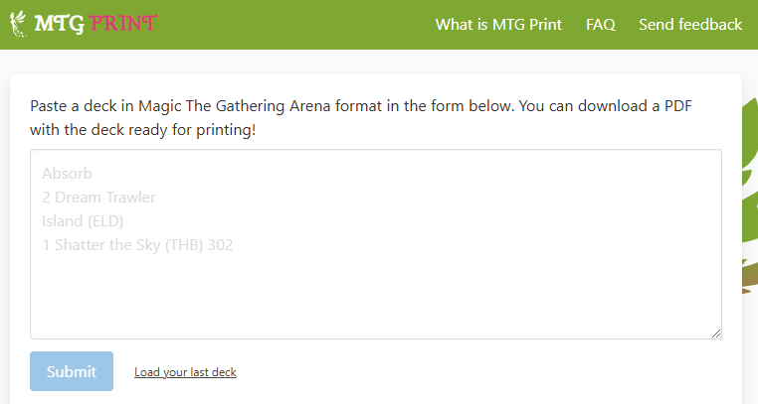

Slide 8
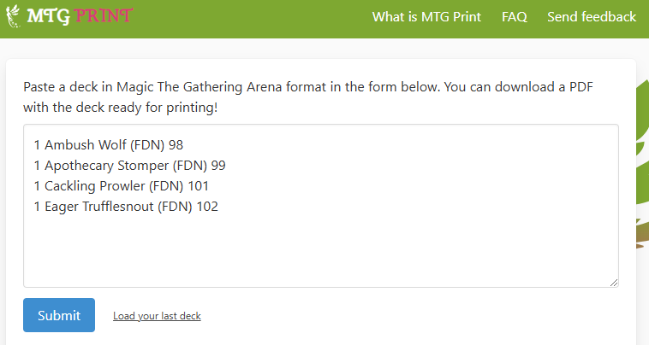

Slide 9
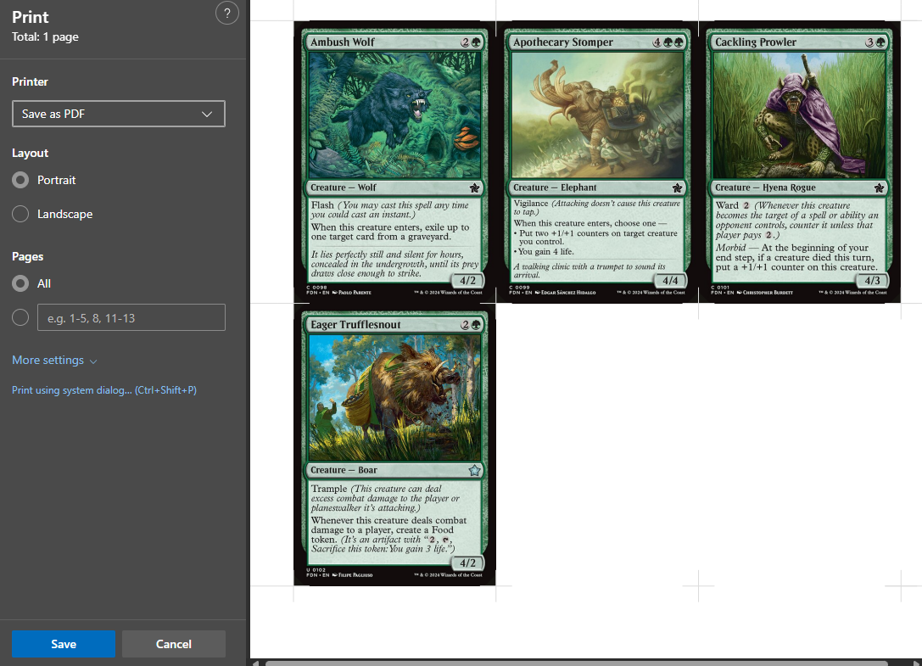

Slide 10
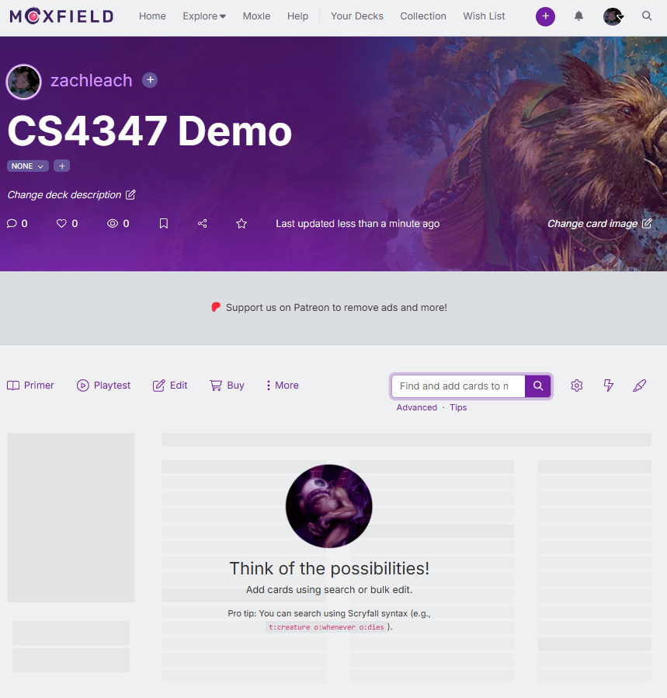

Slide 11
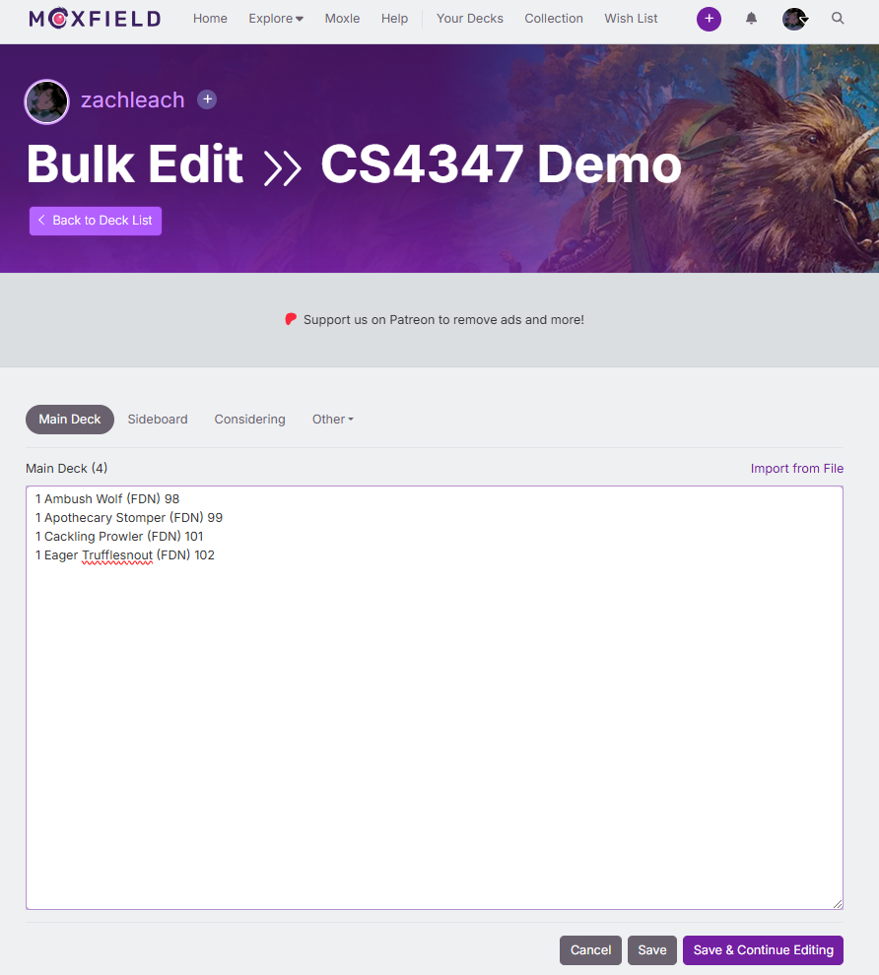

Slide 12
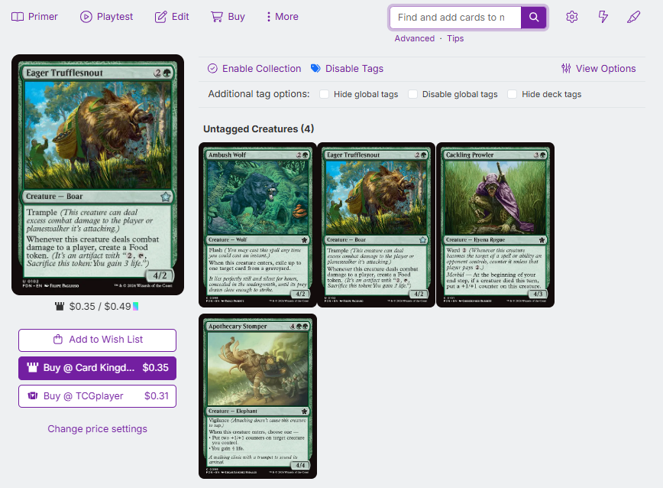

Slide 13
Project Goal
Phase 1: Implement database for our application
Phase 2: Implement web application utilizing that database

Slide 14
Project Goal
Phase 1: Implement database for our application
Phase 2: Implement web application utilizing that database

Slide 15
Conceptual Model

Slide 16
Conceptual Model Entities
CARD_INFO
Primary Key:
card_name (string)
Attributes:
type_line (string)
power (int, nullable)
toughness (int, nullable)
color identity (char[])
colors (char[])
converted mana cost (int)
mana cost (string)
rarity (char[])

Slide 17
Conceptual Model Entities
CARD_PRINT
Primary Key:
card_name (string)--> CARD_INFO.card_name
set (string)
set_number (int)
Attributes:
artist name (string)
uri to unique prints (string)
uri to png download (string)
flavor text (string)

Slide 18
Conceptual Model Entities
CARD_PRICE
Primary Key:
card_name (string) --> CARD_PRINT.card_name
set (string) --> CARD_PRINT.set
set_number (int) --> CARD_PRINT.set_number
seller (string)
Attributes:
tix (double, nullable)
usd (double)

Slide 19
Conceptual Model Entities
ANALYTICS
Primary Key:
card_name (string) --> CARD_INFO.name
format (string)
Attributes:
tix (double, nullable)
usd (double)

Slide 20
Conceptual Model Entities
LIMITED_ANALYTICS (disjoint child of ANALYTICS)
Primary Key:
inherited by ANALYTICS
Attributes:
win rate when main decked (double)
play rate (double)
win rate opening hand (double)
win rate drawn turn 1 or later (double)

Slide 21
Conceptual Model Entities
COMMANDER_ANALYTICS (disjoint child of ANALYTICS)
Primary Key:
inherited by ANALYTICS
Attributes:
edhrec rank (int)
salt score (double)

Slide 22
Entity Relations
1. CARD_INFO to CARD_PRINT
2. CARD_PRINT to CARD_PRICE
3. CARD_INFO to ANALYTICS
4. ANALYTICS to LIMITED_ANALYTICS
5. ANALYTICS to COMMANDER_ANALYTICS
Notes:
cardinfo: card stats
card print: multiple art styles
cardprice: different art style different prices
analytics: stats on two popular deck formats

Slide 23
EER Diagram

Slide 24
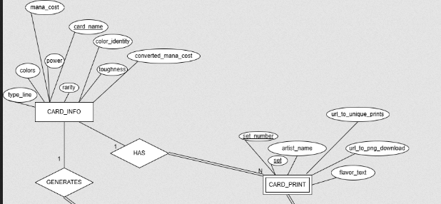
CARD_INFO to CARD_PRINT (1:N)
A card can have multiple prints. Multiple prints can belong to one card.
Total participation: a card print cannot exist without a card itself
Notes:
Tolu: Talk about why each entity/relation is modeled the way it is (e.g., why is a given relation 1 to N, why is something represented using total participation, etc)

Slide 25
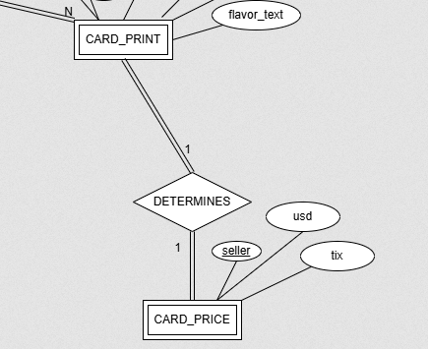
CARD_PRINT to CARD_PRICE (1:1)
A card print determines its price.
Total participation: Prints must be associated with a certain price.

Slide 26
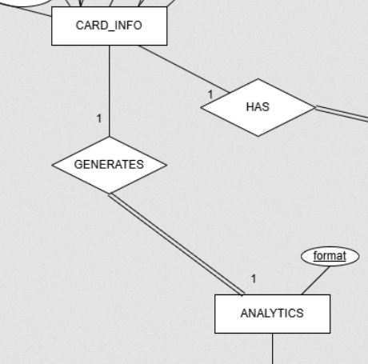
CARD_INFO to ANALYTICS (1:1)
1 analytics per card
Total participation: All cards are associated with analytics.

Slide 27
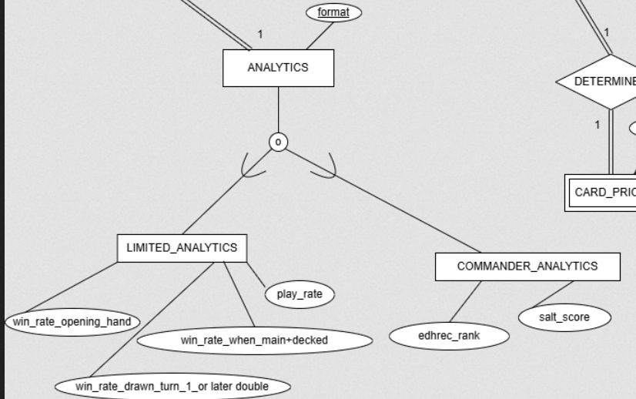
ANALYTICS Superclass & Its Subclasses
A card can be a limited card (LIMITED_ANALYTICS), a commander card (COMMANDER_ANALYTICS), or both (overlapping subclasses)

Slide 28
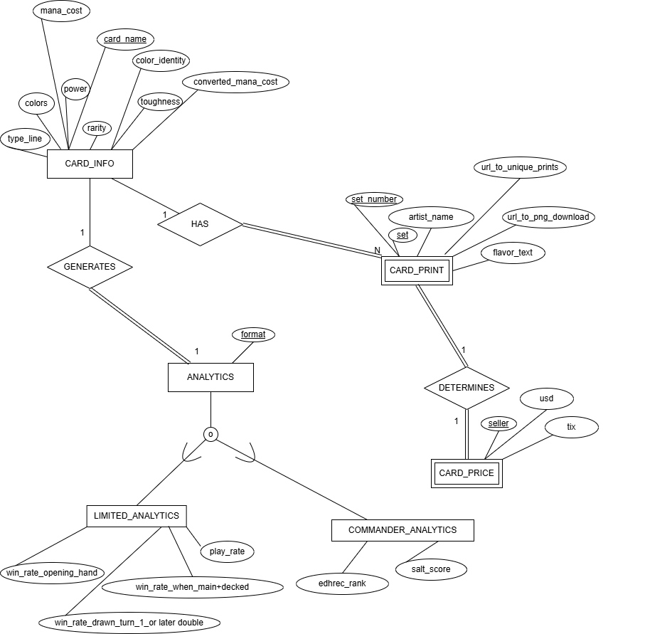
EER Diagram

Slide 29
Relational Model
Notes:
Ashley: Explain our relational model and the foreign/primary key relationships

Slide 30
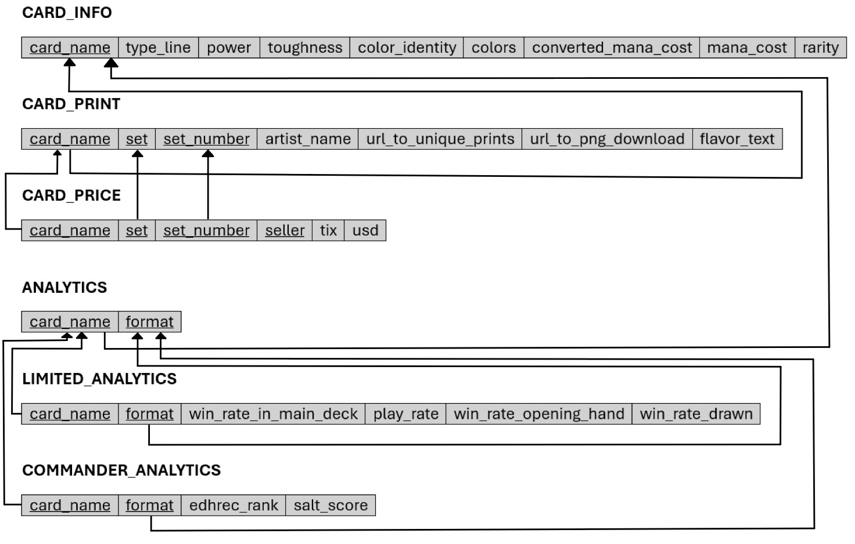
Relational Model

Slide 31
Relational Model
PK
FK

Slide 32
Relational Model
PK
FK

Slide 33
Relational Model
PK
FK

Slide 34
Relational Model
PK
FK

Slide 35
Relational Model
PK
FK

Slide 36
Relational Model
PK
FK

Slide 37
Relational Model
PK
FK

Slide 38
Relational Model
PK
FK

Slide 39
Relational Model
PK
FK

Slide 40
Normalization
Notes:
Hayden:
Functional Dependencies (FDs)
Normalization Schemes
1NF
2NF
3NF

Slide 41
Functional Dependencies
An attribute Y is functionally dependent upon an attribute X if and only if there is a unique Y for each value of X.
In other words, there cannot be two different Y values for the same X.

Slide 42
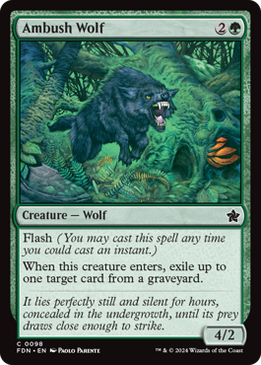
Functional Dependencies (cont.)
Ex: CARD_INFO (with some attributes)
card_name | power | toughness | colors | mana_cost | cmc

Slide 43
Functional Dependencies (cont.)
Ex: CARD_INFO (with some attributes)
FD1
FD2
There can be multiple FDs per relation
card_name | power | toughness | colors | mana_cost | cmc

Slide 44
Normalization Schemes
1NF - All attributes depend upon the key
2NF - All attributes depend upon the whole key
3NF - All attributes depend upon nothing but the key

Slide 45
1NF and 2NF Normalization
Example of 1NF and 2NF
card_name | type_line | power | toughness | color_identity | colors | cmc | mana_cost | rarity
set | set_number | seller | tix | usd | card_name

Slide 46
3NF Normalization
Example of 3NF violation
There is a transitive dependency in this relation
Transitive dependencies are a violation of the 3NF condition
card_name | type_line | power | toughness | color_identity | colors | cmc | mana_cost | rarity

Slide 47
Decomposition
Notes:
Explain how we resolved the functional dependencies through decomposition

Slide 48
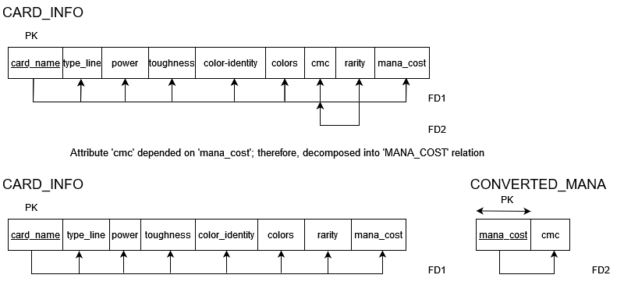

Slide 49
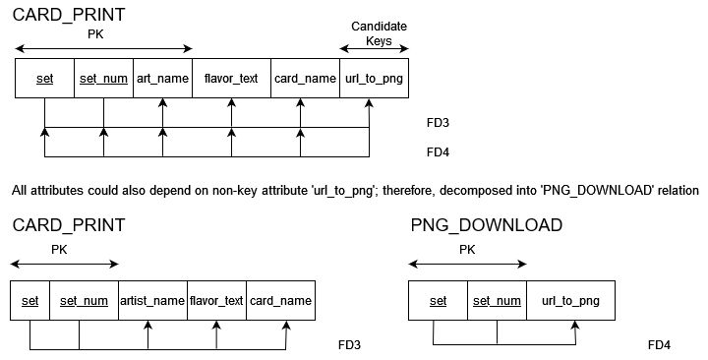

Slide 50
Implementation

Slide 51
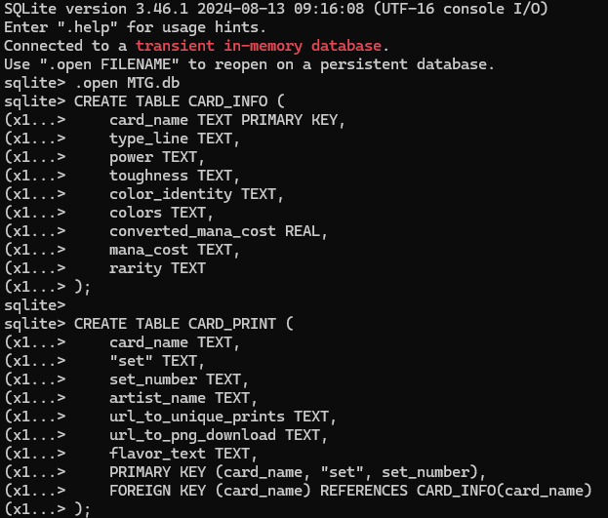
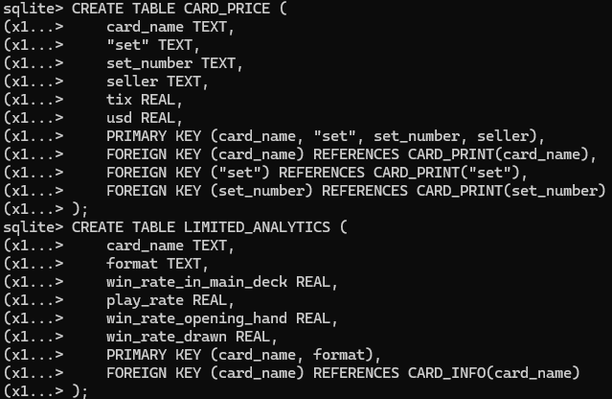
Implementation
First established a database schema using SQLITE3.
Used VS Code as my environment to view the database using the SQLite Viewer extension.

Slide 52
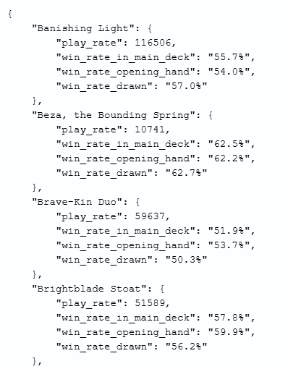
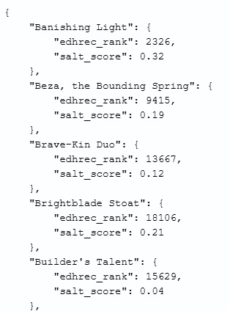
Implementation
Created a script to filter a subset of cards from different public databases for our given database design.
Generated separate JSON files for each table in the database.
Combined these separate JSON files to create a master file that would be used to populate the database.

Slide 53
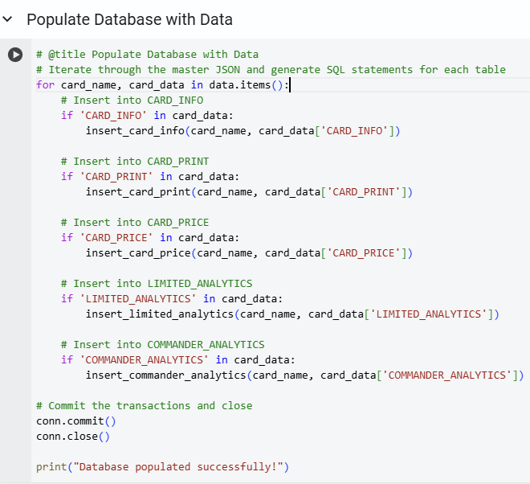
Implementation
Used the master JSON file to automatically generate SQL code to populate the database.

Slide 54
User Interface

Slide 55
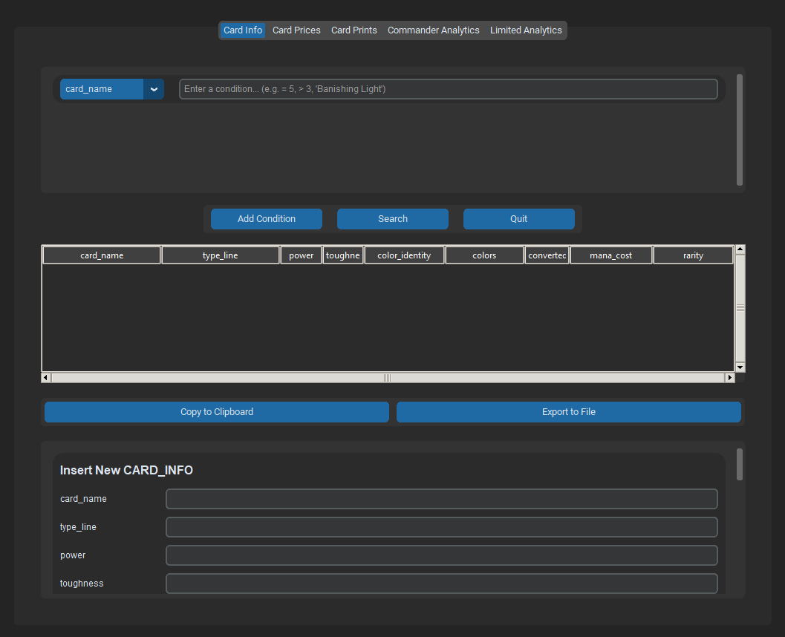
User Interface
Used the previously created SQLITE3 database to create a user interface using Python.
Created the user interface using CustomTkinter for modern, customizable GUI components.
Used different tabs to represent the different entities of the database.

Slide 56
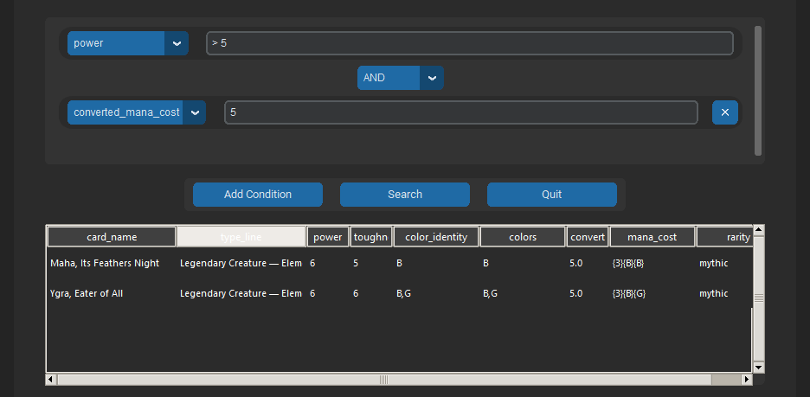
Features
Can create customizable queries to filter card data.
User can search using multiple conditions with logical operators (AND/OR).

Slide 57
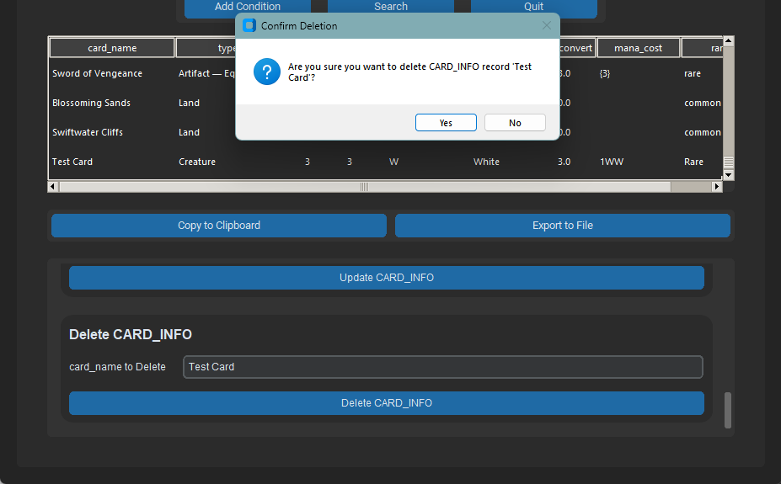
Features
User can also:
Insert cards into the table
Update cards in the table using the card’s name
Delete cards from the table using the card’s name
User is notified when a valid operation is successfully completed

Slide 58
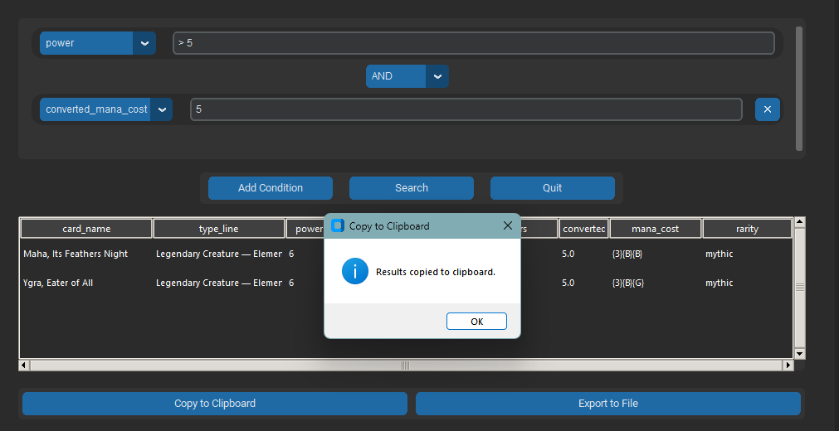
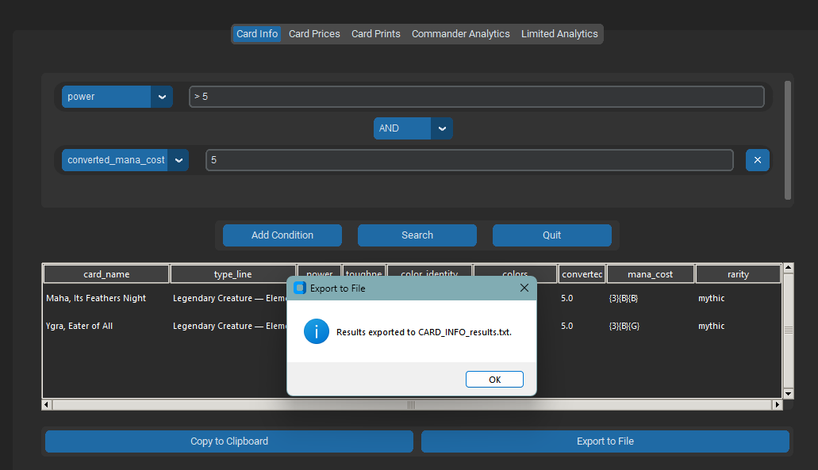
Additional Features
Copy results to clipboard for easy sharing
Export the results to a .txt file for later use

Slide 59
Conclusion

